Slide 1

Code written business stories.
www.rinftech.com

Slide 2


Who we are.
RINF TECH is a technology and engineering company which enables organizations’ growth through digital transformation.
We bridge the gap between hardware and software, delivering innovative digital products and services. We are specialized in automotive software, enterprise applications for digital transformations, artificial intelligence research & development and robotics automations.
Started locally, developed globally – RINF TECH is an entrepreneurial organization, which expanded in Europe, featuring 4 delivery centers in Bucharest, Timisoara, Kyiv, Sofia and business offices in Berlin, London and Paris.
Recently we have developed our own product, building on our strategy of expanding our R&D and Robotics capabilities: MATT, a complete testing solution for devices that incorporate any physical input such as touchscreens or buttons.

Slide 3

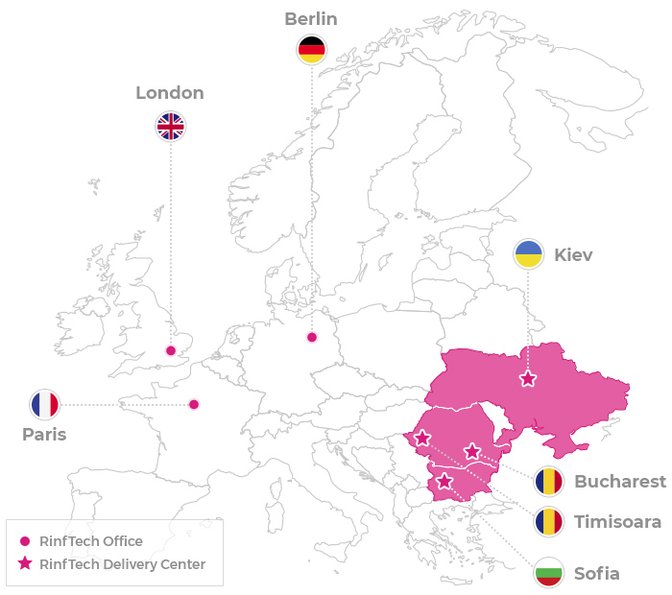




RINF TECH
Software & hardware service provider
2006 established in Bucharest, Romania
2016 delivery center in Sofia, Bulgaria
2018 delivery center Kiev Ukraine
2019 delivery center in Timisoara
350 employees: 250 in Bucuresti, 30 Sofia, 20 Timisoara, 50 Kiev

Slide 4

Technical Organization.
All projects organized in 4 Technical Clusters
4 Cluster Managers oversee projects across all Delivery Centers
Each Cluster Manager acts as company-level integrator for all technical delivery functions
Synergies between Technical Clusters allow for:
Shared Knowledge Base across the entire Technical Team
Ability to undertake complex integration projects
Value propositions that span across multiple technology stacks, methodologies & practices

Slide 5
Technical Clusters.
Enterprise Applications
R&D and Embedded
Business Applications Cluster provides next-level business software development services. With our objective of designing and developing quality software products, we offer a variety of development services that cater to various software project requirements. From start-ups to large-scale organizations, our developers can work with any development project being technology & industry agnostic.
R&D embedded cluster is focused on delivery solutions for embedded industry and to conduct R&D projects for our customers at a fraction of their cost, keeping the quality at high levels. The R&D cluster teams master cutting edge technologies in Embedded, IoT, AI, Cloud development and other similar areas using various development languages, techniques and project methodologies. The R&D cluster engineers are committed to deliver great projects starting from an idea, defining the architecture and implementing a full product.
Robotics & Automation
Automotive
Part of RINF TECH's Technical Core department, the Robotics and Automation department is focused on delivering custom robotics solution by taking ownership of all aspects required to have a working system. The robotics cluster has the capabilities to take an idea and do all the development necessary, from electronics design, embedded software, drivers, 3D modeling and mechanics, physical production of the product and the certifications for different standards, according to European and international standards.
RINF TECH's own robotics solutions help our customers by creating custom robots specifically tailored to their needs and requirements.
Part of RINF TECH's Technical Core department, the Automotive Cluster is a strong vertical, focusing on the delivery of great value for Automotive embedded ECUs.
We have a proven experience in delivering Automotive projects such as: Instrument Clusters, Infotainment Systems, Body Domain Controllers.
Our expertise is built around C Embedded development for all ECUs, C++ development for rich featured ECUs like the Infotainment Systems, Diagnostics, Validation & Verification capabilities.
We support our customers with custom tailored teams, projects and solutions designed to meet their needs.

Slide 6

RINF TECH Technical Clusters.
Enterprise Applications
R&D & Embedded Systems
Robotics
Automotive
140 engineers
50 engineers
10 engineers
120 engineers
Domains:
CRM, XRM
Cloud Platforms
Retail – 23 geos – Suppliers, Article, Replenishment, Contact, Store Group
Customer & Order, Cashier Mgm etc.
IoT Integrations
Public Key Infrastructure
OCR & Electronic Archive
Command Center GIS
Smart Toys
Marketplace Development
Process, method & standards:
Scrum, ScrumBan, PMP / Prince2, Kanban
Tool examples:
Jira, Git, BitBucket, Confluence, Jenkins, Kubernetes, Puppet
Technology:
Java (SpringBoot, SpringCloud), .Net (Core, UWP), EAI, Angular, NodeJS, Python, C++, Cloud Services, Serverless, Microservices
Domains:
Machine Learning, Deep Learning
Virtualization & Cloud Technologies
Smart Conf Room – Sentiment Analysis
IoT Devices & Protocols
Wireless Modules
BLE Bluetooth Low Energy
Device Efficiency
Secured Connectivity
ARM processors
Augmented & Mixed Reality
Modified kernels for FaaS
Complementary Domains:
Long and Short Range Connectivity
M2M Applications
Communication Protocols:
NBIoT, LTE, UMTS, GSM, LoRaWan
Process, method & standards:
SCRUM, SAFe
Tools & frameworks:
Docker, Kubernetes, MicroServices, FaaS, AWS, Azure, OpenStack, OpenVINO, OpenCV, CUDA, AR Core, AR Kit, Vuforia
Unity, WebGL
Sensors, Actuators
Domains:
Product Hardware Design & Simulators
Motor Control
Automated Industrial Display Calibration
Automated Device Testing
PCB & Analog Simulations
3D Modelling
System Design & Integration
Computer Vision
Complementary Domains:
ROS Robotic OS
HMI Systems
Sensors
Interfaces:
HMI, I2C, Zigbee, CAN, SPI, GPIO, USART, I2S
Process, method & standards:
SCRUM, XP
Tools:
Gazeebo, Physics Simulators, SolidWorks, Unreal Engine
Domains:
Infotainment
Instrument Clusters
ADAS
Diagnostics
Steering Systems
HMI
Complementary Domains:
Telematics & Connectivity
HUD
Rear seat entertainment
Process, method & standards:
ASPICE, AUTOSAR, AGILE, SCRUM
Tool examples:
Green Hills Probe, CANoe, PROVETech, SpeedGoat, BECKHOFF, Renesas Flasher, HackRF One, HIL Simulators

Slide 7

RINF TECH
Delivery Capabilities

Slide 8















































Team Extension.
Customer’s Responsibility
Customer
RINF TECH
RINF TECH‘s Responsibility
RINF TECH will consult on this
As per agreement
Project Setup & Resources
Team Setup & Ramp-up
Project Team Management
Project Delivery
Methodologies
Hardware
Tools
Team
Structure
Technical
Validation
Team
Organization
Technical
Coordination
Corrective
Actions
Hardware
Scope
Of Work
Tools
Deployment
Team Setup
WIP Management
Issue
Management
Delivery
Measurements
Delivery
Structure
Software
Tool Stack
Recruitment
Process
Knowledge
Transfer
KPI Management
Requirements
Deliverables
Continuous
Improvement
Deliverables
Initial
Ramp-up
Plan
Trainings
Work-load
Estimation
Timesheets
Deliverables
Deliverables
Project
Architecture
SDLC Tool
Accounts
Hardware
Bring-up
Team
Scale-up
Process
KPI/SLA
Report
Improvement
Proposals
Software
Licenses
Hardware
Tools
HR
Interviews
Technical
Validation
Project Resource
Planning
Access to
Project Wiki
Team
Project
Plan
Team
Onboarding

Slide 9


















Coordinated Team.
Customer’s Responsibility
Customer
RINF TECH
RINF TECH‘s Responsibility
RINF TECH will consult on this
As per agreement
Project Setup & Resources
Team Setup & Ramp-up
Project Team Management
Project Delivery
Methodologies
Hardware
Tools
Team
Structure
Technical
Validation
Team
Organization
Technical
Coordination
Corrective
Actions
Hardware
Scope
Of Work
Tools
Deployment
Team Setup
WIP Management
Issue
Management
Delivery
Measurements
Delivery
Structure
Software
Tool Stack
Recruitment
Process
Knowledge
Transfer at
Project
Start-up
KPI Management
Requirements
Deliverables
Continuous
Improvement
Deliverables
Team
Ramp-up
Plan
Trainings
Project
Delivery
Report
Work-load
Estimation
Deliverables
Deliverables
Project
Architecture
SDLC Tool
Accounts
Hardware
Bring-up
Team
Scale-up
Process
KPI/SLA
Report
Timesheets
Quality
Report
Software
Licenses
Hardware
Tools
HR
Interviews
Technical
Validation
Project Resource
Planning
Improvement
Proposals
Access to
Project Wiki
Team
Deployment
Plan
Team
Onboarding

Slide 10















Managed Team.
Customer’s Responsibility
Customer
RINF TECH
RINF TECH‘s Responsibility
RINF TECH will consult on this
As per agreement
Project Setup & Resources
Team Setup & Ramp-up
Project Team Management
Project Delivery
Methodologies
Hardware
Tools
Team
Structure
Technical
Validation
Team
Organization
Technical
Coordination
Corrective
Actions
Hardware
Scope
Of Work
Tools
Deployment
Team Setup
WIP Management
Issue
Management
Delivery
Measurements
Recruitment
Process
Knowledge
Transfer at
Project
Start-up
Knowledge
Transfer
During Project
Delivery
Deliverables
Validation
Delivery
Structure
Software
Tool Stack
KPI Management
Requirements
Deliverables
Continuous
Improvement
Deliverables
Team
Ramp-up
Plan
Trainings
Project
Delivery
Report
Work-load
Estimation
Deliverables
Deliverables
Project
Architecture
SDLC Tool
Accounts
Hardware
Bring-up
Team
Scale-up
Process
KPI/SLA
Report
Timesheets
Quality
Report
Software
Licenses
Hardware
Tools
HR
Interviews
Technical
Validation
Project Resource
Planning
Improvement
Proposals
Access to
Project Wiki
Team
Deployment
Plan
Team
Onboarding

Slide 11


















Solution Delivery.
Customer’s Responsibility
Customer
RINF TECH
RINF TECH‘s Responsibility
RINF TECH will consult on this
As per agreement
Project Setup & Resources
Team Setup & Ramp-up
Project Team Management
Project Delivery
Methodologies
Hardware
Tools
Team
Structure
Technical
Validation
Team
Organization
Technical
Coordination
Corrective
Actions
Hardware
Scope
Of Work
Tools
Deployment
Team Setup
WIP Management
Solution
Architecture
Issue
Management
Delivery
Structure
Software
Tool Stack
Recruitment
Process
Knowledge
Transfer at
Project
Start-up
Delivery
Measurements
Solution
Delivery
KPI Management
Deliverables
Continuous
Improvement
Knowledge
Transfer
During Project
Delivery
Full Solution
Validation
Requirements
Ramp-up
Plan
Initial
Hardware
Bring-up
Deliverables
Deliverables
Deliverables
Project
Architecture
SDLC Tool
Accounts
Team
Scale-up
Process
HR
Interviews
Delivery Plan
Project
Delivery
Report
Quality
Report
Software
Licenses
Hardware
Tools
Project Initial
Trainings
Technical
Validation
KPI/SLA
Report
Work-load
Estimation
Improvement
Proposals
Access to
Project Wiki
Team Project
Plan
Team
Onboarding
Project Resource
Planning

Slide 12



















Incident Management.
Operating
Context
Prioritization
Scope
Of Work
Operating
Flows
Problem
Management
ITIL
Methodology
Provide
Workaround/
Resume
Business
Raise Ticket
Triage
Root-cause
Analysis
Incident
Management
Final Solution
Implementation
Ticket
Management
Tools
Governance
Processes
Operating
History & Initial
Knowledge
Base
Impact
Analysis
Update
Knowledge
Base
Update
Disaster
Recovery
Update
Business
Continuity
Plan

Slide 13













Managed Services
Customer’s Responsibility
Customer
RINF TECH
RINF TECH‘s Responsibility
RINF TECH will consult on this
As per agreement
Initial Input
Service Management
Service
Requirements
Technical
Requirements
Service
Design
Knowledge
Transfer Plan
Team
Structure
ITIL
Methodology
Business
Context
Service
Operation
Planning
Service
Reporting
Structure
Service
Quality
Planning
Service Bill
of Materials
Quality
Requirements
Delivery
Structure
Service
Transition
Planning
SLAs
Preventive
Maintenance
Planning
Service
Continuity
Planning

Slide 14
























Managed Services
Customer’s Responsibility
Customer
RINF TECH
RINF TECH‘s Responsibility
RINF TECH will consult on this
As per agreement
Service Transition
Service Delivery
Transition
Milestones
Definitions
Team
Onboarding
Team
Ramp-up
Plan
Backlog
Management
Service
Change
Management
Technical
Coordination
Triage
Service
Setup
Deployment
Initial
Knowledge
Acquisition
Clarifications
& Change
Management
Corrective
Actions
Preventive
Actions
Issue
Management
KPI
Report
Service Design
Calibration
Quality of
Service
Reporting
Service
Reporting
Continuous
Improvement
Knowledge
Acquisition
Shadowing
Calibration
Ongoing Operations
Knowledge
Acquisition
Report
Service
Volumetrics
Report
Service
Complexity
Report
Operations
Against SLA
Report
Quality of
Service
Reporting
Service
Delivery
Report
SLA
Coverage
Report
Knowledge
Tools &
Techniques
Critical-
To-Quality
Report
Knowledge
Base Update
Ready for
Operations
Report
Knowledge
Base Update
Quality of
Service
Reporting
Improvement
Actions
Knowledge
Update
Process
Service
Recalibration
Report
Service
Change
Management
Knowledge
Base Update
Preventive
Actions
Report
Knowledge
Dissemination
Report
Service
Continuity
Report

Slide 15
Technical Delivery Governance.
 | Contract Management
 | Scope of Work
 | Automotive ClusterManagement | R&D ClusterManagement | LoB Apps ClusterManagement | Robotics ClusterManagement |  | ISO 9001
 |  |  |  |  |  | ISO 27001
Project Management | Vertical Specific Technical Governance | Vertical Specific Governance | Vertical Specific Governance | Vertical Specific Governance |  | Technical Delivery | PMI, PRINCE2, SAFe, CMMI Approach, Tools, Reporting, Change Mgmt, Proj Driving & Escalations, Output Wrap-up
Product Management | Automotive Product Consultancy | Customized, Cutting-edge, Future Product Consultancy | B2B2C, B2C, XaaS Application Product Consultancy | Robotic Arms & Tools, Autonomous Robots, Computer vision enabled Robots |  |  | Product Vision, Product Design, Go-To Market Strategy, Monetization
Technical Guilds | Autosar, RTOS, CAN ---------------- Embedded C, C++, Python automation, Automotive Specific Tools & HW Setups | IoT, AI, ML/DL, Linux, Networking, Embedded ---------------- C++, Python, Go | Saas, Distributed, Applications, SPA, Mobile Apps ---------------- .NET, Java, React, Angular, SQL/ No-SQL, Cloud, Microservices | Embedded Development, C++, Python, ROS, electro-mechanics, drivers, physical integrations |  |  | Technical Principles, Patters, Practices, Frameworks, Blueprint Makin, Flows, Tools, Dev Env Setup, Cloud Infrastructure, CI/CD
Allocation Management | ASPICE, AUTOSAR trained team, industry specific trainings | Engineering team structure, Research Setup, Equipment Setup & Config, Prototype benches | Agile & XP task-forces setup, Continuous skillset training, Hands-on workshops, Team Setup | Ultra-specialized Multidisciplinary Engineering Team |  |  | Blueprint Design, Flows & Diagrams, Technical Principles, Standards, Patterns, Practices, Frameworks
Quality Management | ASPICE ---------------- Agile, SCRUM | Benchmarking, Level of optimizations, device resources consumptions ---------------- Agile, SCRUM | SAFe, ITIL QoS, Code-Coverage, ISTQB ---------------- Agile, SCRUM | In-depth, testing for: fit-for-purpose, reliability, durability, radiation standards, speed & precision |  |  | Automation Principles & Tools, Test Env. Setup & Config., Quality Control Policies ITIL-based Approach, Standards & Practices
 | Cross-Vertical Cooperation
 | Real-time Visibility & Reporting
 | Output Calibration

Slide 16

RINF TECH
Strategy

Slide 17
Service Value Pyramid.
Product Company
Customer driven POCs
Technical POCs and proofs of feasibility
Processes Mgmt., Delivery Models, Certifications, QMS, Tools, Automation, Reporting, Methodologies, Patterns and Practices
Experience Design
Market Analyzes & Strategy, UI/UX, Design Thinking
Engineering Software & Hardware
Product & Platform Engineering, Custom Software Development,
Custom Hardware Components, Integration Factory
Digital Components
AI, Content Engineering, Cloud & DevOps,
IoT, Robotics, QA as a service, Big Data & Analytics

Slide 18

Aspiration map - Automotive.
2019
2020
2021
2022
Future State
2023
Body of Knowledge & Best Practices for Autonomous Driving Projects
5M Eur from Future
Automotive
1 Project delivered with knowledge from Automotive & Robotics Collab
Automotive
Managed Services:
3M EUR
Dedicated Team for Adroid OS/AGL
1 Team Extension
Explore
open-source Automotive Techs
Second level of maturity in managed services
Automotive Lab
Established Tier 1 Supplier
Innovation
ASPICE L4
Total team
size: 500
First level of maturity in managed services
2 end-to-end ECU development projects - shared team
The core is able to switch to any automotive technology
ASPICE
level 4
1 end-to-end ECU development project
HQ Team Size: 200
Core of
Hardware & Software embedded engineers
ASPICE level 3
Total team size: 300 people.
Development
Deliver ECU Development work packages
Receive ASPICE level 2
Have a portfolio of at least 3 Tier 1 providers as our clients
Team proficient in ECU development
Current State
Start the ASPICE process
Team extension-volumetric growth
ECU development
ASPICE
Cluster growth
Notes:
HW Debug Tools: Revenues of 10 mil EUR assumes a net profit of at least 70%. Each tool can be tailored specific for a client and on client budget.
ECU Development: AGCO, BMW

Slide 19
Aspiration map - R&D & Embedded Systems.
2019
2020
2021
2022
Future State
2023
AI Competence Center
2M Revenue
AI services increase to 600K.
400k from Microchip Partnership
400k from AI Services. First revenue from Microchip partnership 100K
Eng Unit 3M Revenue
CV integration with smart conference room;
Microchip partnership AI services Revenue 250K
AR/MR Unit 1.5 M
AI / ML / DL
Automation Excel Center 5 M Eur
Algorithms implementation
Integrate with IoT / robotics
Computer Vision use cases
POCs
500K from internally
dev IoT devices
1M from Smart City
Projects
200K from Smart Conf.
300k from Smart City
AR/MR eBody of Knowledge
Team Size: 20
Automation Unit – 50 Engineers
2.5M Eur
100K Eur from Smart Conference 100k from Smart City projects
200k Eur from AR/MR Projects
Automation Dedicated Team
1M Eur
IoT
Drivers development Smart Conference Device
1 Augmented & Mixed-Reality Project
First investment in AR/MR
2 Automation Projects
>200K Eur
Add experience;
Investigate virtual assistant feasibility and have a POC
Current State
Consolidate Automation Capabilities
Augmented reality
Automations

Slide 20
Aspiration map - Enterprise Applications.
2019
2020
2021
2022
Future State
2023
RINF TECH
Body of Knowledge
RINF TECH Projects Factory Dev Practices & Delivery Processes standardization
Learning Center
Unit Specialization
RINF TECH Comando Team
Architecture Practices
Multi-unit 7M Rev
Technical Guilds
Set premises for high
Performance
Software practices
Specialized Centers
10+ M Eur
Technical
Practices
RINF TECH Ecosystem 3+M
Services Excellence Center
5M Revenue
Fast Scaling
Processes
2000 eng
AI / ML / DL
Services Center
3M Revenue
RINF TECH
Delivery Center
7M Eur Revenue
.
Product Delivery
2M Revenue
Sustained Prod Lifecycle
Established ITIL practices Structured Mid-size AMS
Multi-center
1000 eng
PMI & SAFe Std Practices
Large-scale Projects
4M EUR
Ad-hoc Managed Services – set prem for practices
Applications Managed Services (AMS)
2 Symbiotic Products
1M Eur
PMI and Cycle
Dev Practices
2M Eur
Industry Specialization
Team Deployment Services
600 ppl
Payable Premium features on Freemium Product Methodology
Industry Vertical driven Team Deployment Processes per Industry 500 Engineers
Ad-hoc Small-size Fixed-Price Projects
1 Freemium SaaS
Used Internally for quality improvement
Team deployment based on Team Services
Current State
Projects
Software Products
Team Services

Slide 21
Aspiration map - Robotics.
2019
2020
2021
2022
Future State
2023
QA Robot as a Service
1M Eur
Robotized QA – 3 M Eur
5 Clients – 1M Eur
Enhanced Computer Vision
Robot Arm Unit 3M Eur
3 Clients - 300k Eur
New Robot Platform
3 Effector Types
MATT Ready for mass Productions
Custom Robotics 5M Eur
QA Robot - MATT
Custom Robot Arm Services
1M Eur
Robotics Assembly Line
Robotics Research Facility
AI / ML / DL
5 Testing Arms Delivered to Production
Custom Robots for a 2nd industry
.
Prototype – Testing Effector on Robot Arm
Robotics Lab
Stage 3
Partnership with an
US Research Center
On Robotics
Custom Robots for retail
deployed regionally to
1 large retailer
Analyze Options for Testing Arms
Robotics Lab Stage 2
Partnership with an European University/Research Center
On Robotics
Robot Arms
1 Custom Robot for Retail
5 Engineers certified - ROS
1 Robotics Research Project with
a local Technical University
Assess feasibility on Custom Robotics with Embedded AI
Current State
Robotics Lab – Stage 1
Partnership with Technical University
Custom Robotics
Robotics Expertise
Robotics Partnership

Slide 22

RINF TECH
Financials

Slide 23
Turnover & EBITDA Evolution 2017-2019.

Slide 25
Financial Projection 2020-2023.

Slide 26
Ambition plan 2025.
1st Goal | 60 mil Euro Revenues by end of FY 2025.
2nd Goal | Aspirations maps accomplished for each technical cluster.
3rd Goal | 20% Organic Growth per year.
4th Goal | 10 % Growth through M&A.
5th Goal | RINF TECH Structure Continue the process for the best structure for companies in the group in terms of operational business development and financial performance thus assuring sustainable and long-term growth platform for RINF TECH teams and Companies.

Slide 27
Directions 2020.
1st Direction | Service Evolution – The pyramid of value
2nd Direction | Automatization and Integration
3rd Direction | Performance Centric Culture with focus on mobility
4th Direction | Holding integration/Group Operations integration

Slide 28

































Clients portfolio.

Slide 29





RINF TECH as Preferred Supplier
for Global Clients.
7 Years
Sofia, Bucharest
Multiple engagement models
Assessment Center
Competence Pool
Quality
7 Years
Bucharest, USA
Offsite Development Center
Certified Top Secret
Fixed Price, Outcome Base
Scalability on demand
4 Years
Romania, France
Automotive ADAS Vision & Radar Products
Motor Control Application
Dedicated Teams
Niched Skills
3 Years
Bucharest
Dedicated Teams
Digital healthcare driven projects
Applications for smart devices
Competence Pool
Quality Assurance
2 Years
Bucharest, Germany
Scientific approach
Robotics & multi-entity interactive systems
AR/VR competences
Empowering innovation
Fixed Price, Outcome Base

Slide 30


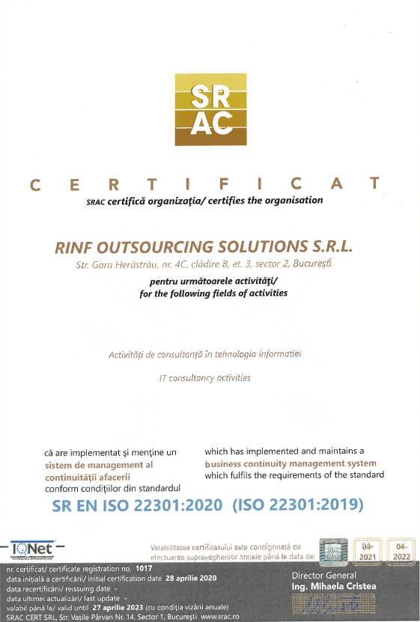
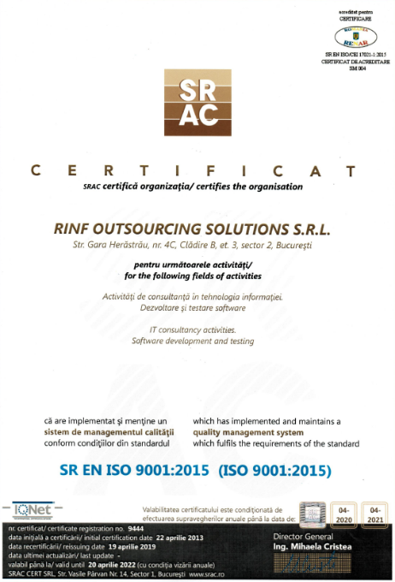

Certifications.
Certifications released by SRAC CERT body, IQNET partner and RENAR accredited - EA-MLA signatory body (European certification recognition agreement).
ISO 9001:2015
ISO / IEC 27011:2017
ISO 20000:2018
ISO 22301:2020

Slide 31


Thank you!
www.rinftech.com

